Slide 1

Web Application technologies
19CSE335 Ethical Hacking

Slide 2
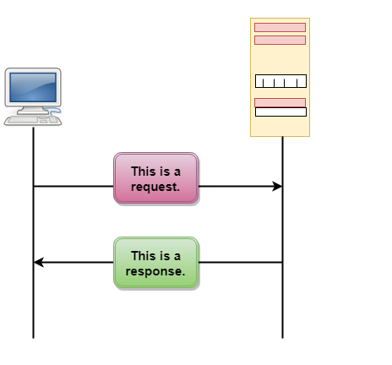
HTTP Protocol
HTTP stands for HyperText Transfer Protocol.
known as HyperText Transfer Protocol because of its efficiency that allows us to use it in a hypertext environment where there are rapid jumps from one document to another.
Uses a message-based model in which a client sends a request message, and the server returns a response message.

Slide 3
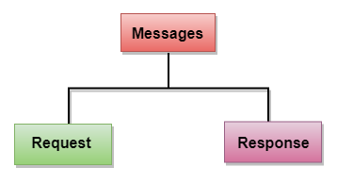

Slide 4
HTTP Requests
The HTTP (requests/responses)message consists of one or more headers.
HTTP requests consist of 3 items in their first line.
GET/POST :-
GET - used to retrieve information from the server.
POST - used to send loads of data to the server for a specific resource
The requested URL
functions as a name for the resource being requested, together with an optional query string containing parameters that the client is passing to that resource.
The HTTP version
The only HTTP version used on the internet is 1.0/1.1, and most browsers used 1.1 default. HTTP version discusses later in this session.

Slide 5
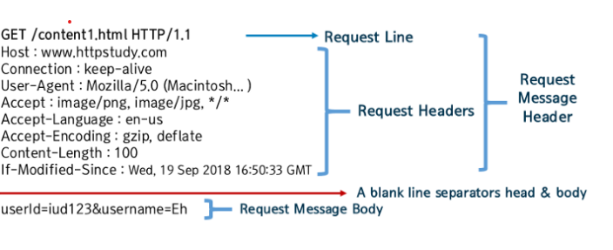
Some other request headers
Referer: URL from which the request originated.
User-Agent: information about the browser.
Host: hostname that appeared in the full URL being accessed. this is necessary when multiple websites are hosted on the same server.
Cookie: submit additional parameters that the server has issued to the client.

Slide 6
HTTP RESPONSES
consists of 3 items in their first line.
HTTP version.
numerical status of the result (i.e. 200).
A textual status of the responses.
Some other request headers
Server: webserver software, installed modules, and server OS.
set-cookies: issue the browser further cookies. this is submitted back to the cookie.
Pragma: browser not to store the responses in its cache.
Expire: content expired in the past and therefore should not be cached.
Content-type: indicates that the body of this message contains an HTML document.
Content-length: message body in bytes.

Slide 7
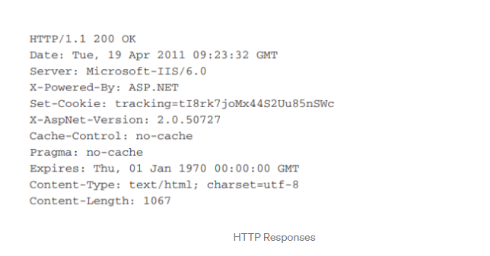

Slide 8
HTTP Methods
GET: It is a method in which data is passed through the URL (as variables) which is visible in the address bar of the web-browser.
POST: It is a method in which data is passed through packets that are not visible to the user on a web-browser. So, it is much safer to use POST instead of GET.

